Slide 1
ansora customer discovery report
Week 3

Slide 2

CEO - Rachel Evans
CTO - Sophie Tanker
CFO - Andra Buchan

Slide 3
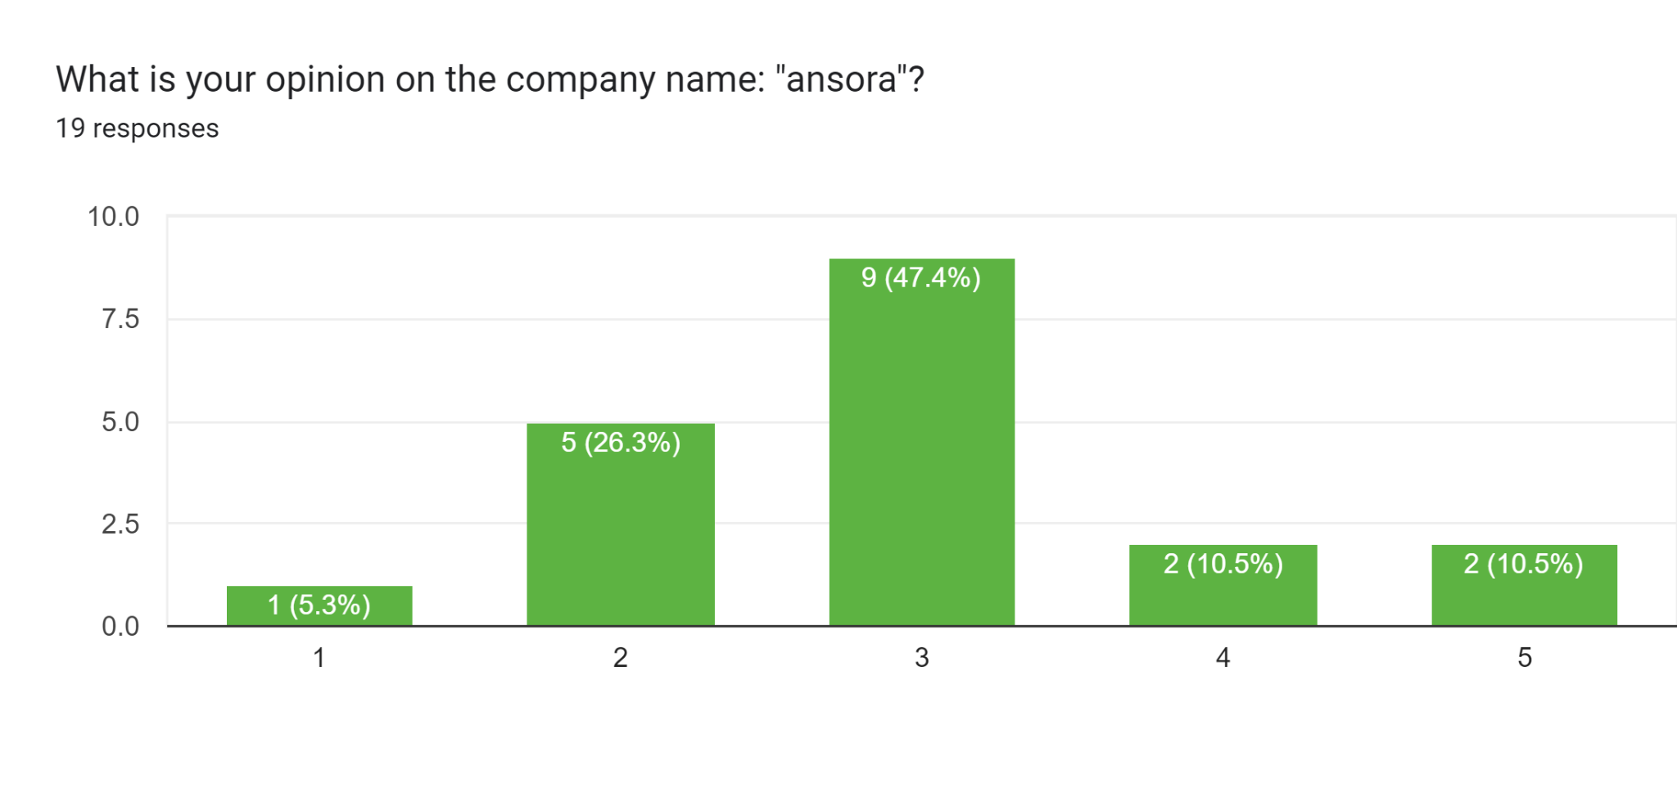
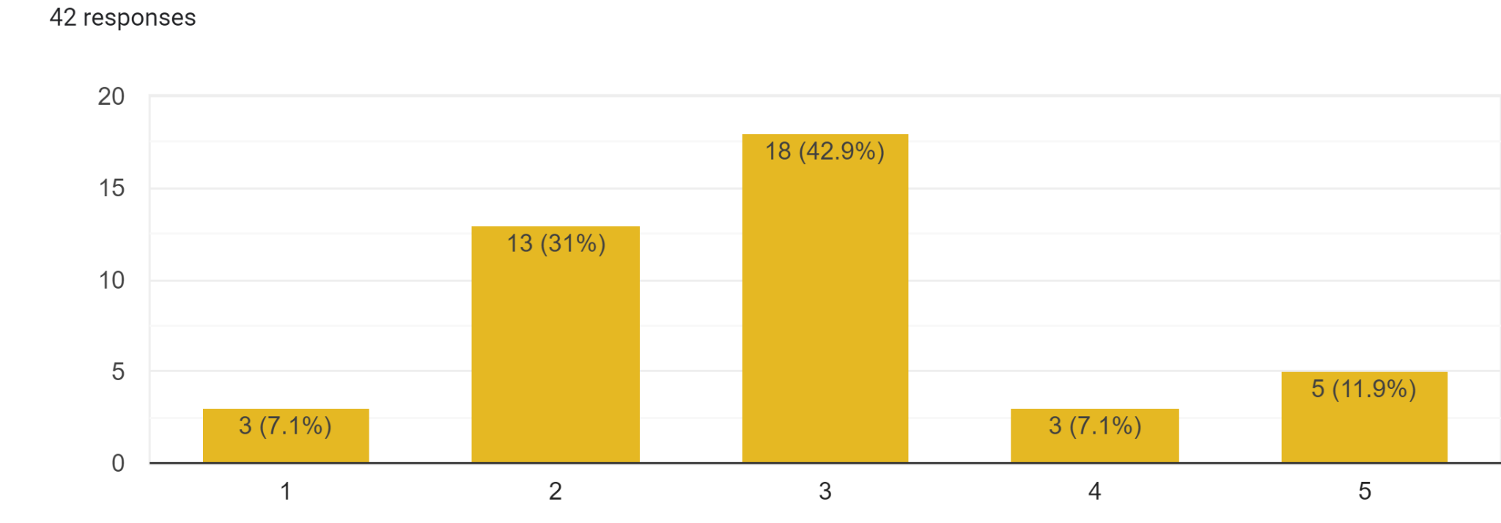

Slide 4
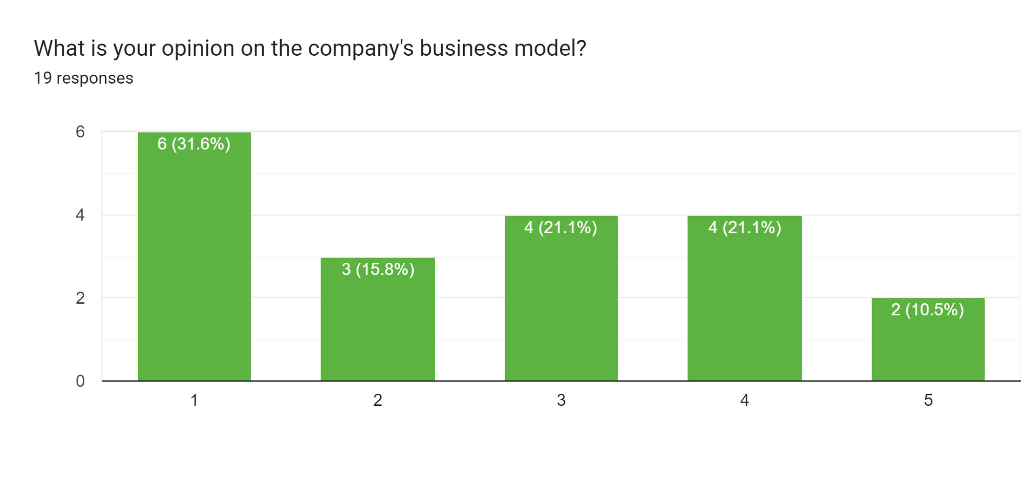
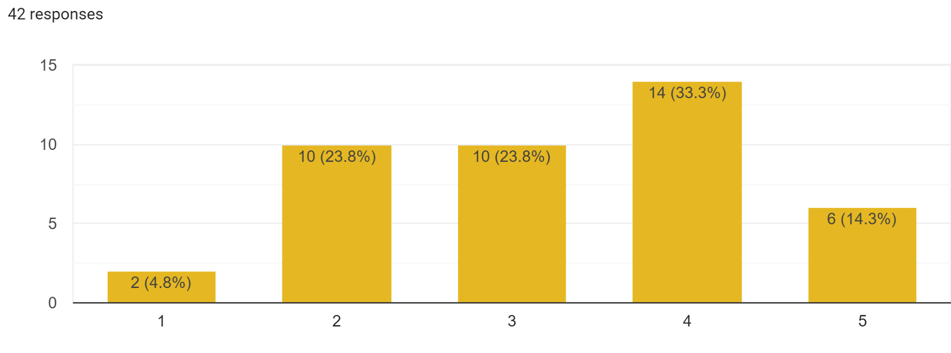

Slide 5
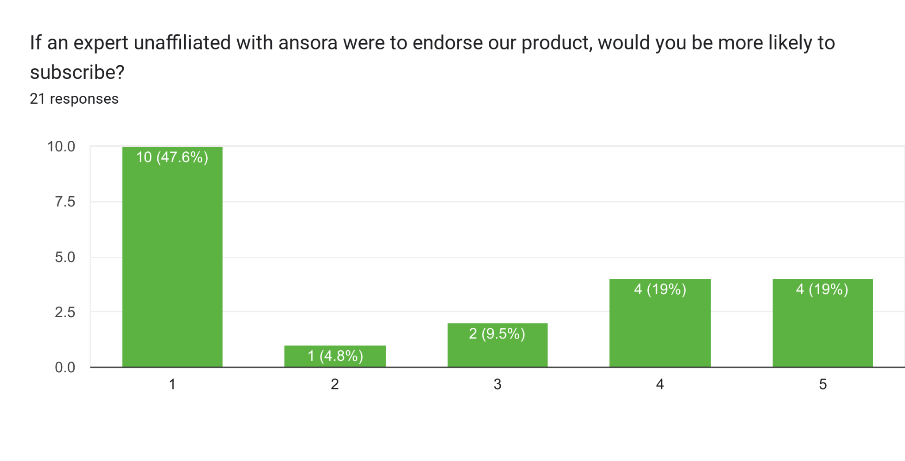

Slide 6
Does our product remind you of any other products?
“Care/of or Ritual”
“23 and Me for the DNA testing.”
“Those pill subscriptions and at home allergy/food sensitivity tests”
“The only other companies that use genetic info are ancesty sites like 23 and Me and their reputation is quite bad “at the moment.”

Slide 7
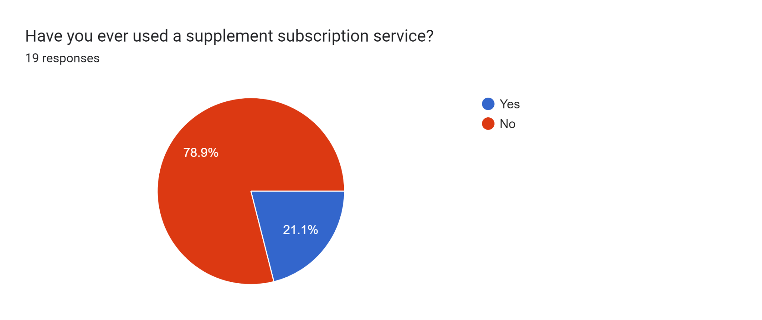
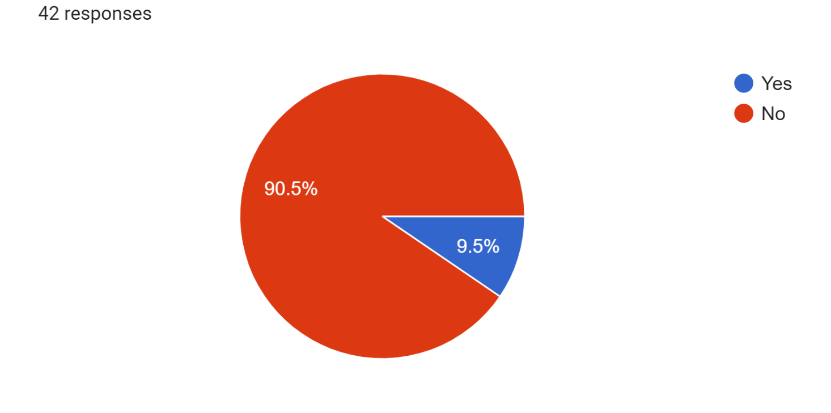

Slide 8
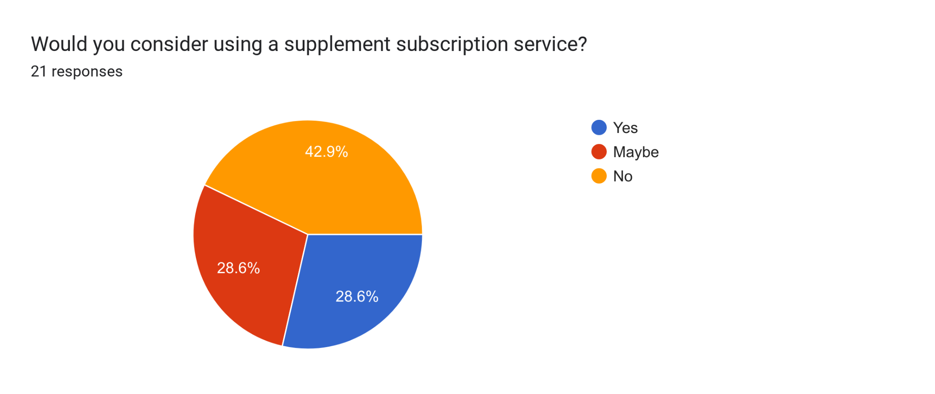
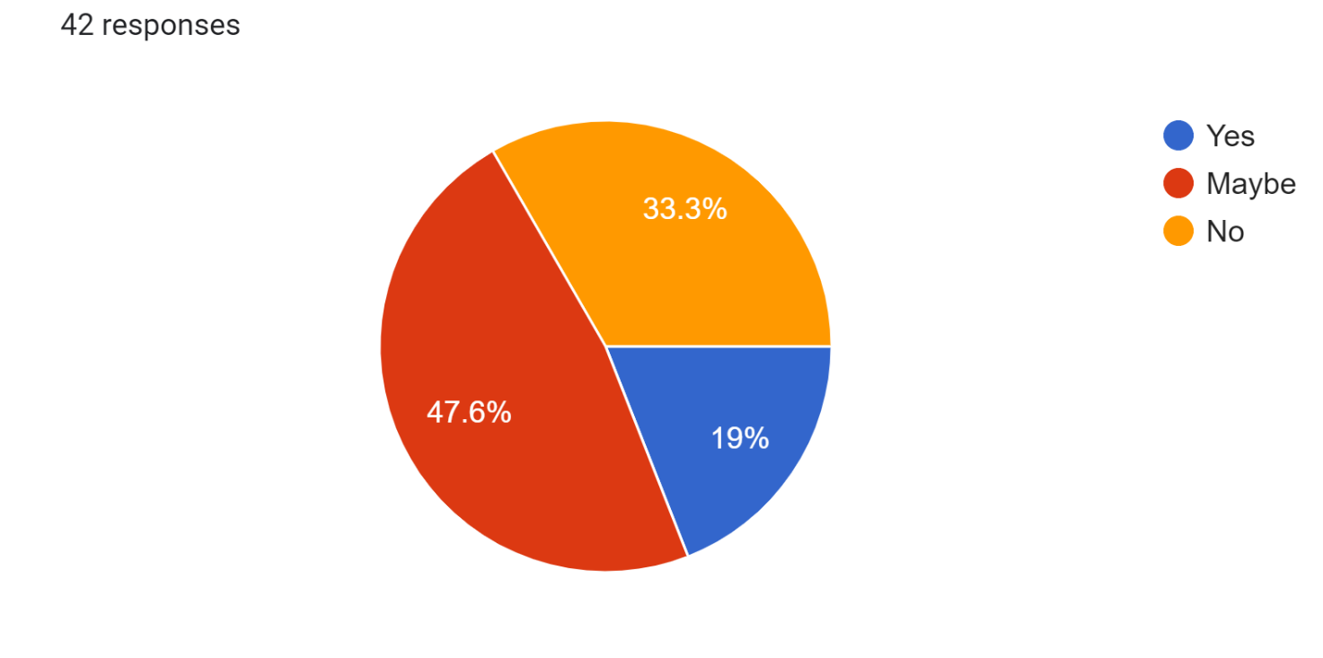

Slide 9
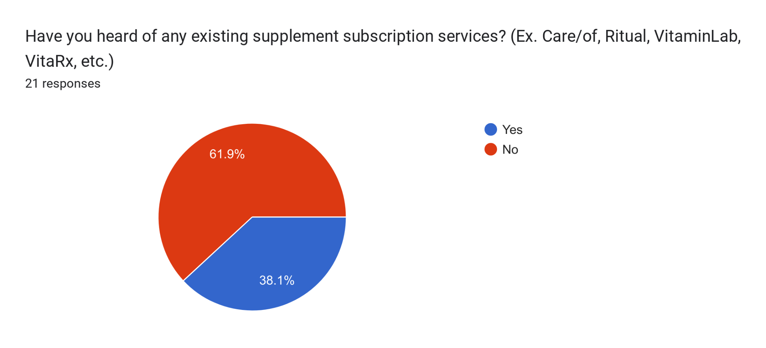

Slide 10
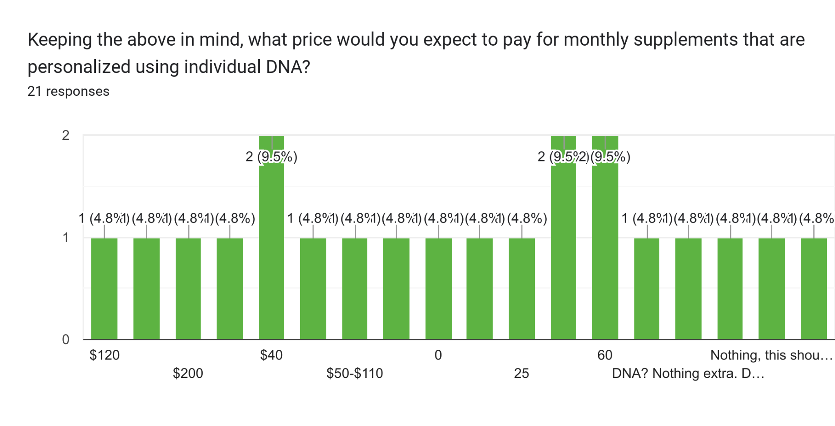
Supplement subscriptions that are currently on the market usually cost between $40 - $100 for each month of pills. These pills use consumer-reported data to inform supplement selection.
Common Responses:
$40
$50
$60
$150
$0

Slide 11
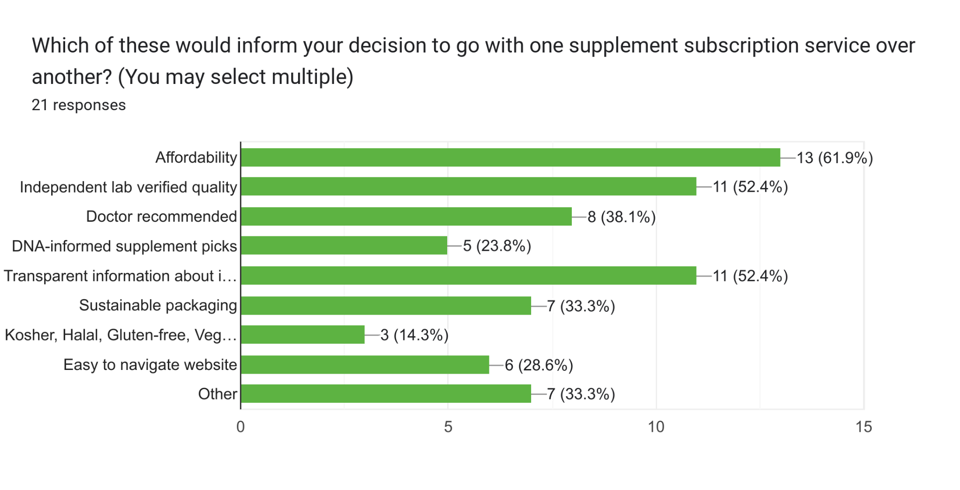

Slide 12
Demographics

Slide 13
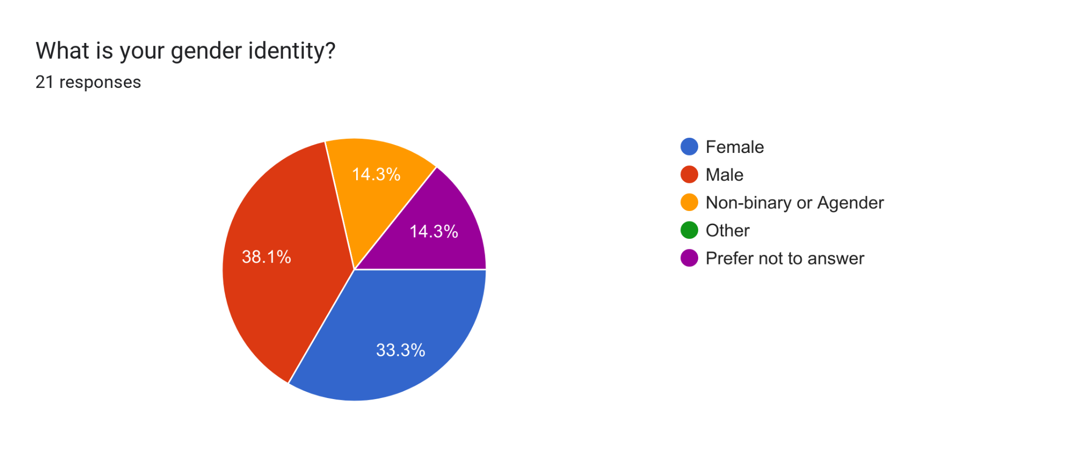
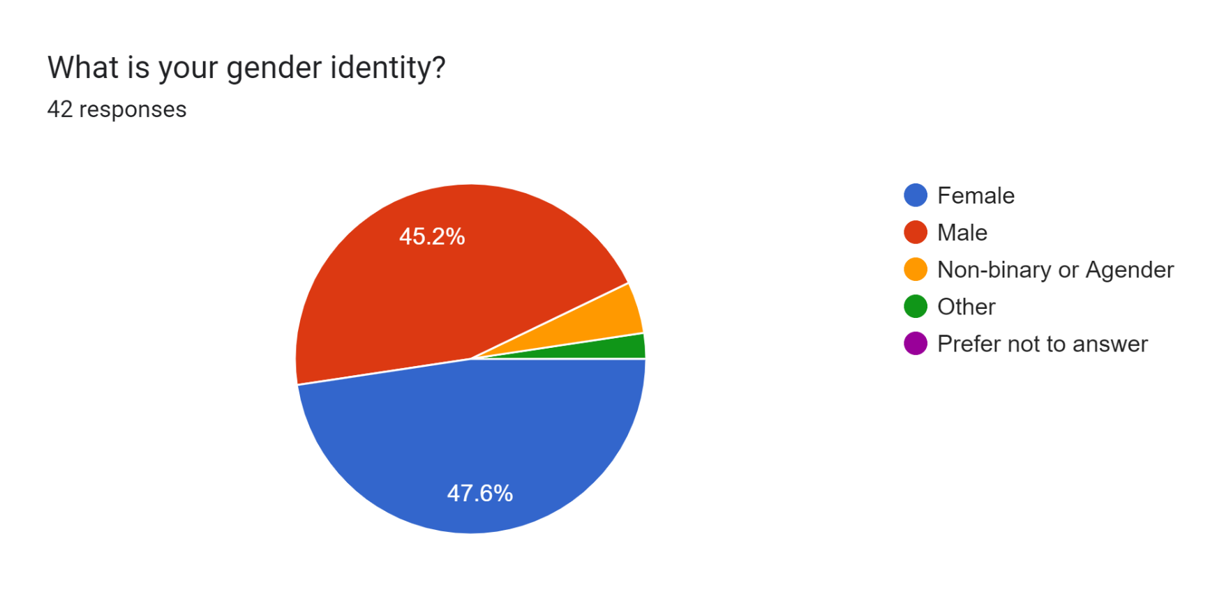

Slide 14
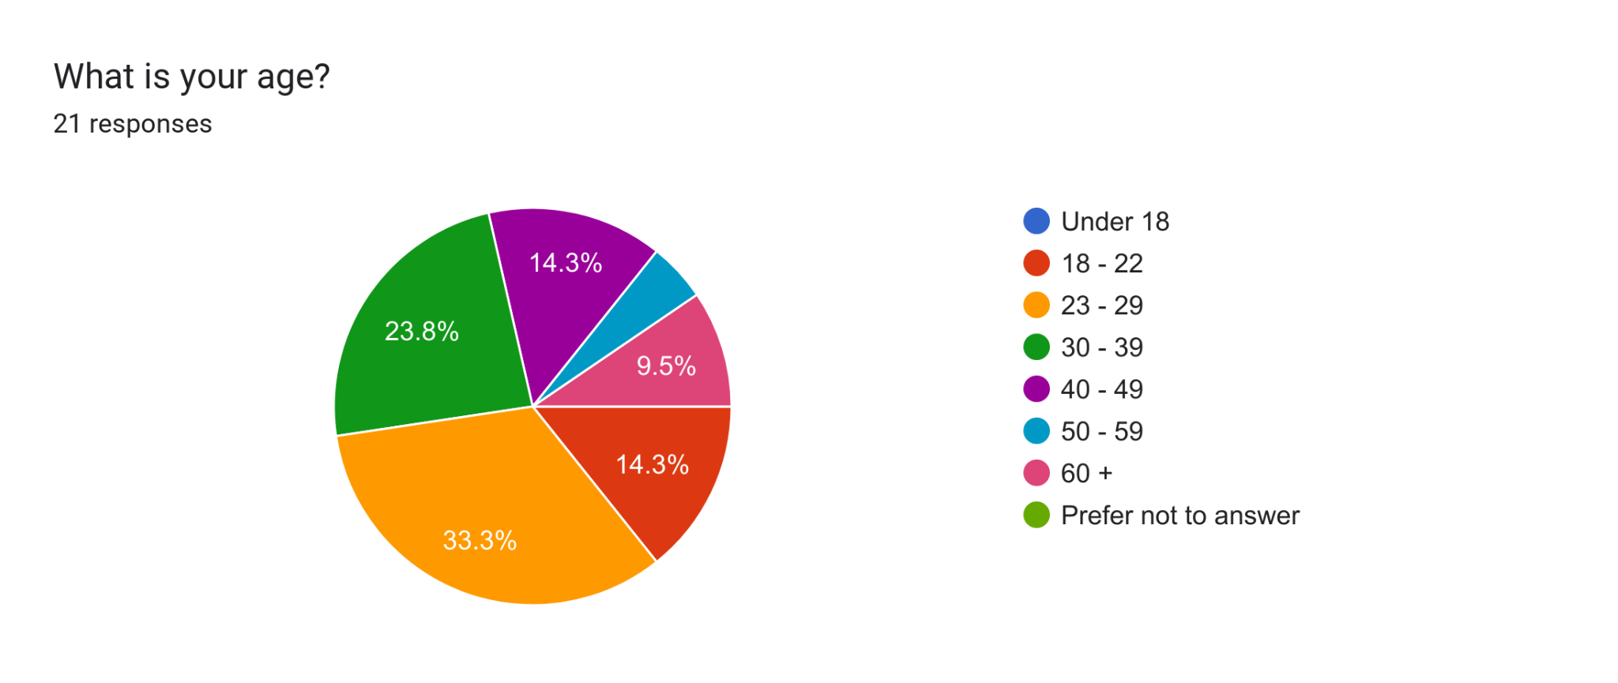
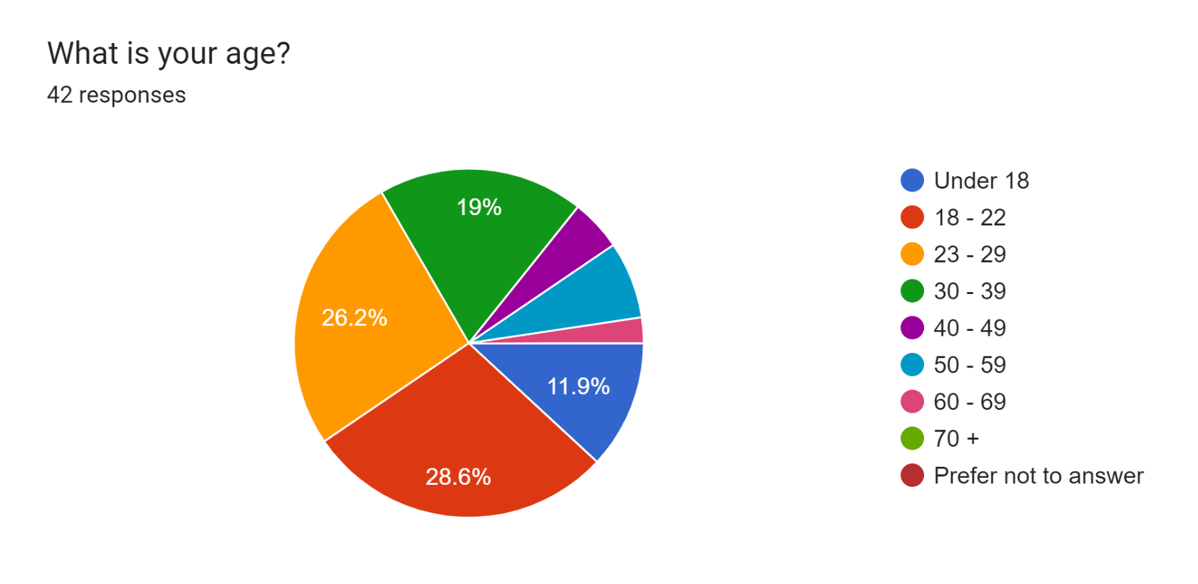

Slide 15
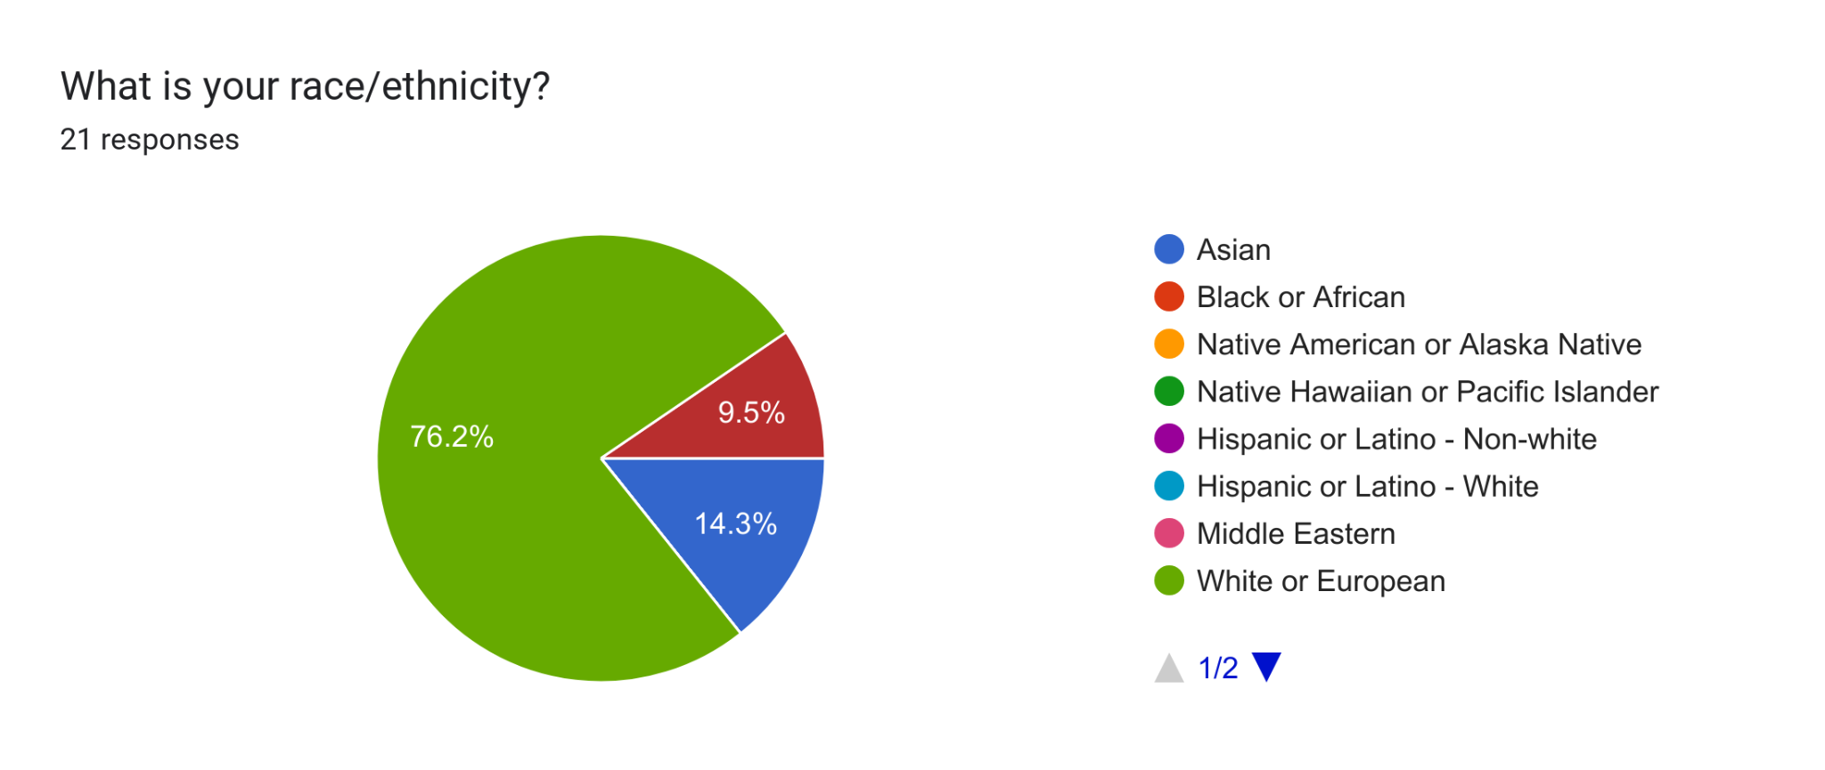
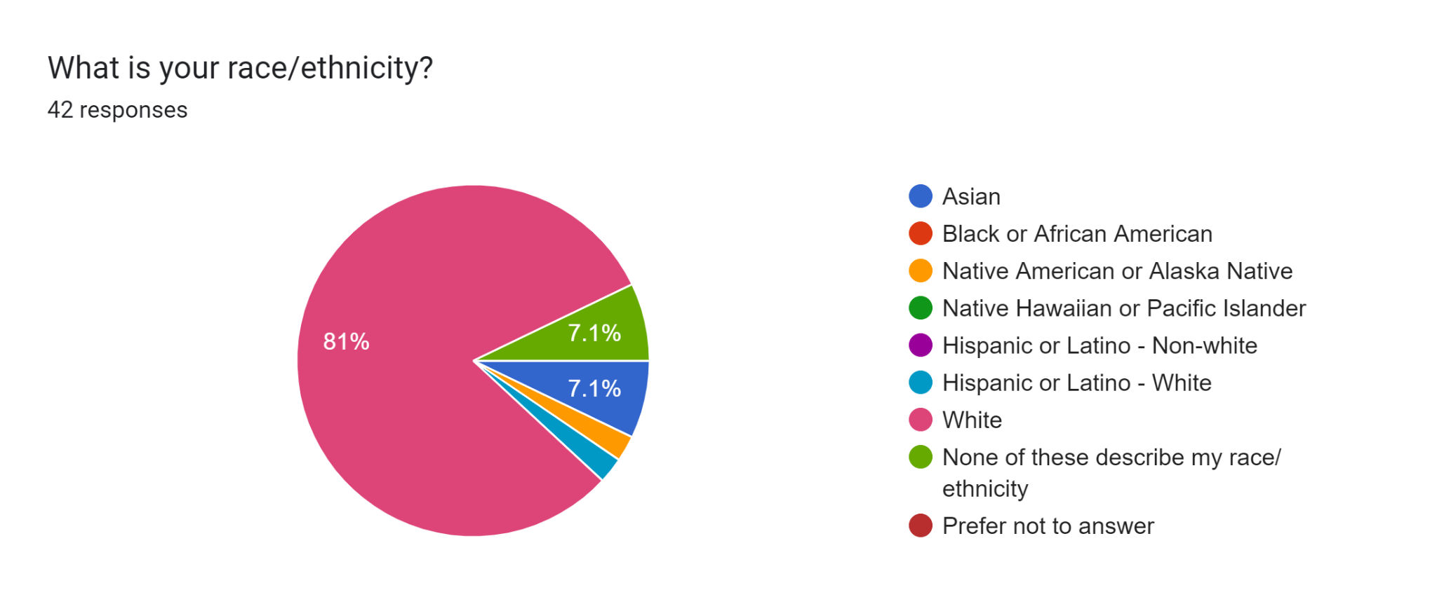
*please note
the colors may represent different groups*

Slide 16
Additional comments
To a layman who has never used a supplement subscription service, DNA-informed suppie selection doesn’t sound that groundbreaking. Independent expert endorsements would help. An easily accessible white paper illustrating how other companies miss things you wouldn’t could be helpful to prospective subscribers
I'm not sure the studies about genetics pricing which antidepressant will work best for you are ready for prime time.... Promising, sure. I pay attention to the overall value, overall utility. How do the costs and benefits weigh out. Given that the vast majority of adults are perfectly fine with a multivitamin...IF that...I don't see the point in investing so heavily in figuring out the optimal supplement regimen for every possible DNA combination. Our money, as a society, would do much more good for baby more people if we spent it laying the prices of healthy foods so someone can buy a alas with grilled chicken for the same price as a Big Mac. BUT... there probably is a market for this among the worried well. I take supplements due to a specific condition that causes malabsorption. Most people don't actually need them.
I would want to know all the details about what kind of testing you do, and how it shows you what vitamins and supplements I need. I also would want proof that the record of my genetic information had been destroyed when you finished using it

Slide 17
Honorable mentions
“what the fuck. i sincerely hope this is just a nonsense student concept and you're not seriously planning on creating yet ANOTHER dna database to inevitably leak”

Slide 18
What have we learned?
A lot of people surveyed through the internet are worried about the privacy and security when it comes to DNA sampling for a business.
We can remedy these concerns by clearly stating our privacy policy and provide details regarding the handling of DNA samples.

